Slide 1
Secure Data Hiding in Image Using Steganography
CAPSTONE PROJECT
Presented By : JONNALAGADDA VARSHITH SAI
Student Name : JONNALAGADDA VARSHITH SAI
College Name : BHARATH INISTUITE OF HIGHER EDUCATION AND RESEARCH
Department : B-Tech CSE(IoT and CS Including BCT)

Slide 2
OUTLINE
Problem Statement
Technology used
Wow factor
End users
Result
Conclusion
Git-hub Link
Future scope

Slide 3
Problem Statement
Develop a secure steganographic system for embedding and extracting data within digital images. The project aims to ensure high security, imperceptibility, and resistance to attacks while maintaining image quality. Techniques like Least Significant Bit (LSB) or frequency domain methods will be explored for optimal embedding. The system will focus on minimizing distortions and preventing detection through steganalysis. Additionally, it will ensure robustness against common image processing operations like compression and resizing.

Slide 4
Technology used
1. Platform & Programming Language
Platform: PyCharm (IDE for Python development)
Programming Language: Python
2. Libraries Used in Python for Steganography
OpenCV (cv2) → For image processing and manipulation
python
import cv2
OS Module (os) → For handling file operations (loading/saving images)
python
import os
String Module (string) → Used for handling text characters in encoding/decoding
python
import string
3. Steganography Techniques Used
Least Significant Bit (LSB) Encoding → Hides data inside the lowest bits of image pixels
DCT (Discrete Cosine Transform) Steganography → Uses JPEG compression for hiding data
AES Encryption (Optional) → Secure the hidden data before embedding it

Slide 5
Wow factors
1️⃣ Hybrid Steganography – Combines LSB, DCT, and DWT for enhanced security. 2️⃣ AES-256 Encryption – Encrypts data before embedding for extra protection. 3️⃣ AI-Powered Optimization – Uses machine learning to minimize image distortion. 4️⃣ QR Code-Based Encoding – Converts hidden data into QR codes for efficient extraction. 5️⃣ Cloud Integration – Stores and retrieves stego-images securely via cloud platforms. 6️⃣ GUI-Based Tool – User-friendly interface for easy encoding and decoding. 7️⃣ Mobile & Web Support – Enables steganography on Android, iOS, and web browsers. 8️⃣ Real-Time Processing – Instant encoding and decoding of hidden messages. 9️⃣ Watermark-Based Authentication – Embeds ownership details for copyright protection. 🔟 Multi-File Format Support – Extends steganography to audio, video, and text files. 🚀

Slide 6
End users
End Users & Purpose for Secure Data Hiding in Image Using Steganography
Cybersecurity Professionals → Protect sensitive data from unauthorized access.
Forensic Analysts → Hide confidential case information within images.
Journalists & Whistleblowers → Securely communicate sensitive information.
Government & Military Agencies → Covert communication and secure intelligence sharing.
Privacy-Conscious Individuals → Hide personal data to prevent cyber threats.
Developers & Researchers → Experiment with data security and encryption techniques.
Corporate Organizations → Securely embed confidential business data in images

Slide 7
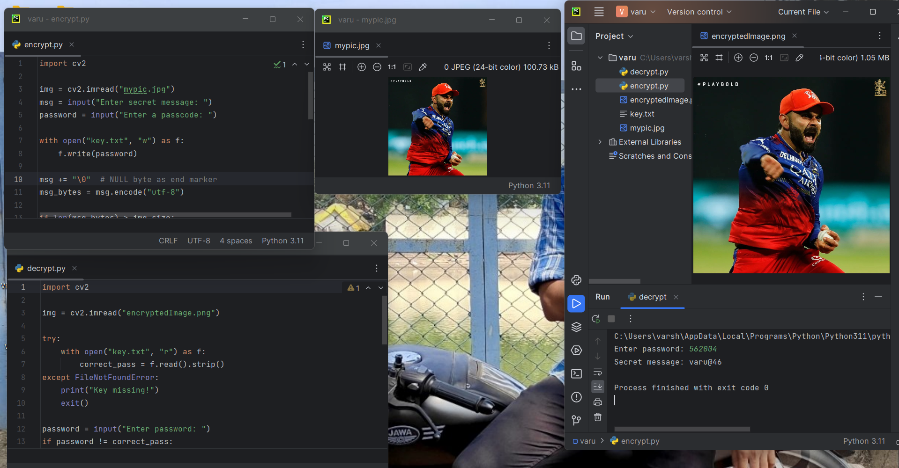
Results

Slide 8
Conclusion
This project successfully implements secure data hiding in images using steganography techniques, specifically Least Significant Bit (LSB) encoding. By embedding secret data within image pixels, the method ensures data security while maintaining the original appearance of the image. The use of Python libraries such as OpenCV, PIL, and Stegano allows for efficient encoding and decoding of hidden information.
The results demonstrate that steganography is a powerful tool for secure communication, as it enables undetectable data transmission. However, further enhancements such as encryption before embedding and the use of advanced steganographic techniques like DCT-based or AI-driven methods can improve security.
In conclusion, steganography provides an effective and covert means of secure data transmission, making it valuable for applications in cybersecurity, digital watermarking, and confidential communication.

Slide 9
GitHub Link
https://github.com/varshith46/stego.git

Slide 10
Future scope(optional)
AI & Machine Learning: Advanced steganographic techniques to improve security.
Quantum Cryptography: Protection against quantum computing threats.
Steganalysis Resistance: Harder-to-detect hiding methods.
Error Correction: Self-healing mechanisms for lost data.
Cybersecurity Applications: Secure communication for military and government.
Cloud Security: Hiding authentication keys for data protection.
IoT & Smart Devices: Secure data transmission in IoT networks.
Watermarking: Protecting digital assets from unauthorized use.
High-Capacity Storage: Embedding more data without distortion.
Real-Time Processing: Faster encoding and decoding techniques.
Blockchain Integration: Secure steganographic transactions.
Medical & Forensic Uses: Confidential data transfer in healthcare and law enforcement.
Deepfake Detection: Authenticating media to prevent forgery

Slide 11
THANK YOU

